Slide 1
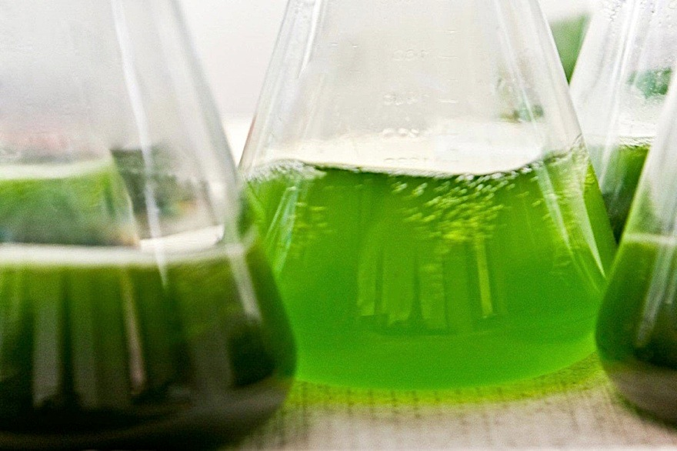
Algofuels
Introduction
Culture
Results
Conclusion
Perspectives
By: Schmeltz Vanessa ; Di Pascoli Thomas

Slide 2
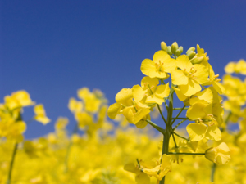
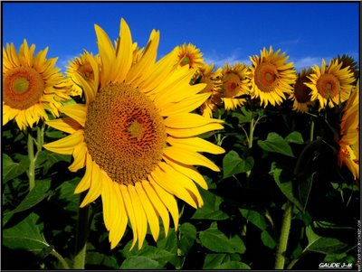
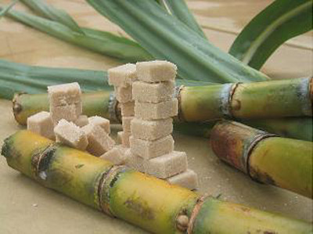
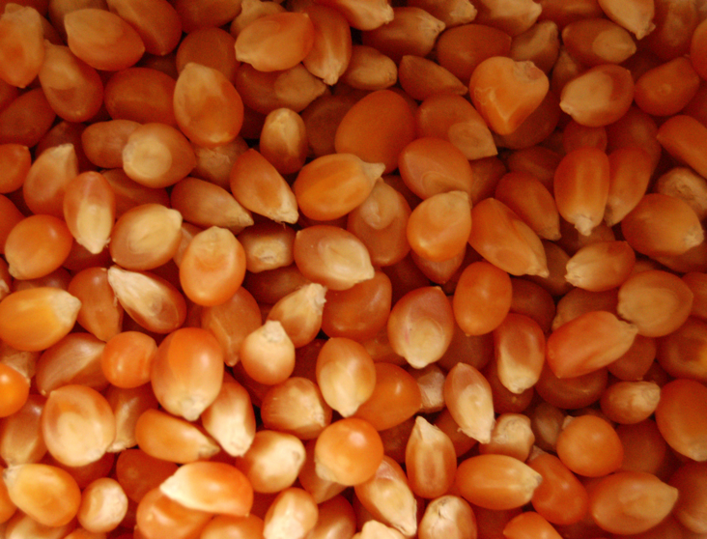
1st generation of biofuel

Slide 3
The alcohol sector → Bioethanol
Produced by microorganisms fermentation.
It can then be partially or completely replace gasoline.
The oil sector → Biodiesel
The vegetable oil used directly in diesel engines, either pure or mixed, but also after processing.

Slide 4
Avantages
Very raw material grown on the globe
Production under control
Inexpensive
Most developed to date

Slide 5
Limits
Competition food / fuel
Requires fertilizers and pesticides
Low energy efficiency

Slide 6
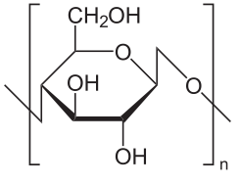
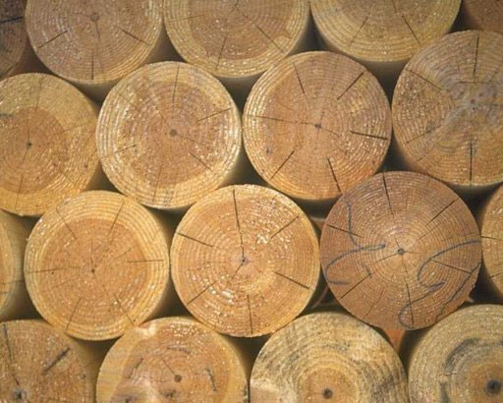
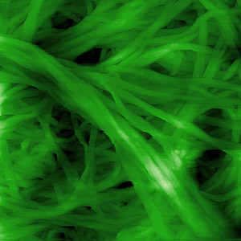
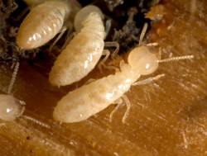
2nd generation of biofuel

Slide 7
Fuel cellulosic
Using biomass composing by the residual non-food parts of plants.
This process converts the cellulose into sugars that are fermented into biofuel.

Slide 8
Avantages
Use of vegetable waste
No use of land for cultivation
No competition food / fuel
More environmentally friendly

Slide 9
Limits
Presence of lignin
Bacterial enzymes with low yields
Low turnover of biomass

Slide 10
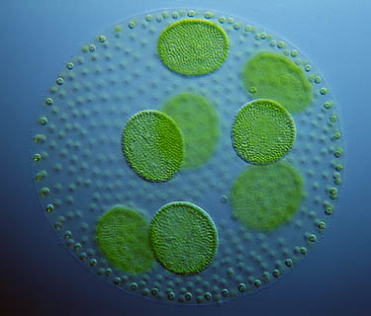
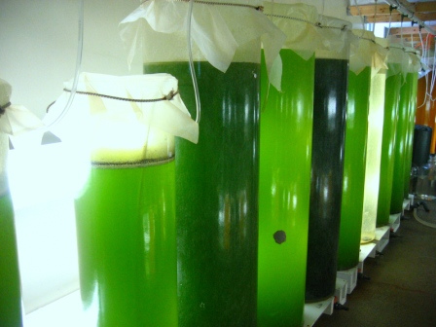
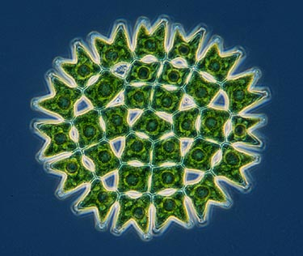
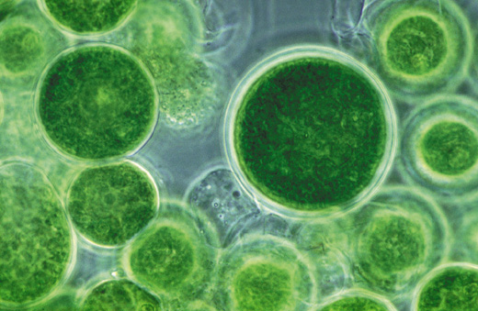
3rd generation of biofuel

Slide 11
« Algofuel »
Based on the high oil content contained in microalgae to produce biodiesel.
Produce 30 times more energy per acre than crops.
Notes:
1 acre = 4,046m².
→ Décrire le mode de production actuel des algues.

Slide 12
Avantages
No competition food / fuel
No deforestation
Culture in the presence of CO2
Culture waste water or salt water
Remediation

Slide 13
Limits
Culture poorly controlled
Low yields for now
High cost

Slide 14
How to increase the production of “algofuels”?

Slide 15
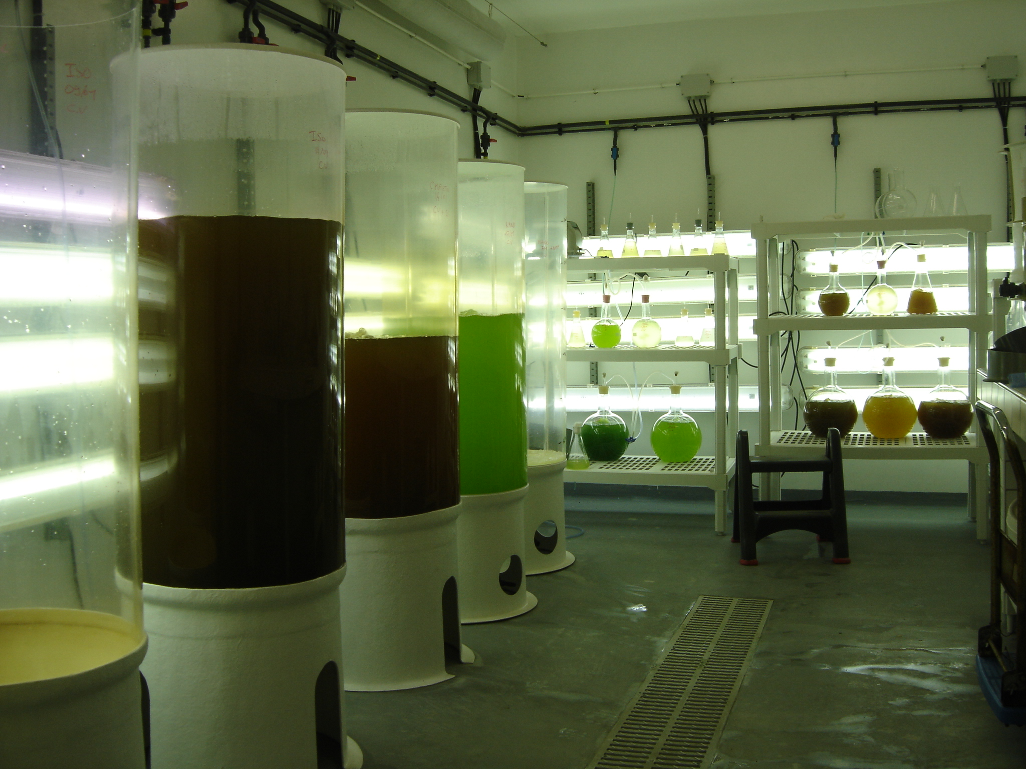
Usual culture
Suspension in a photobioreactors
Concentration: 0.1-1g/L
Harvest by sedimentation or floculation, then centrifugation

Slide 16
Problems of production in suspension:
→Adaptation period before growth of cells
→Difficulties of harvesting algae
→Low yields
Expensive!!!

Slide 17
Light source
Lid
Nutrient medium
Algal biomass
Growth chamber
Supporting substrate material
Fixing algae in media
Rocking mechanism

Slide 18
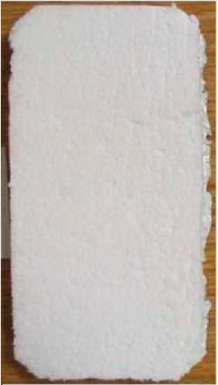
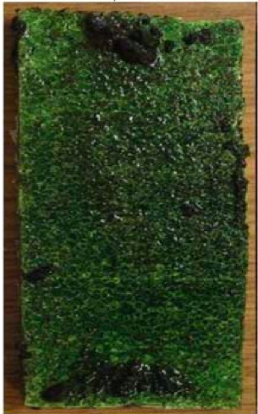
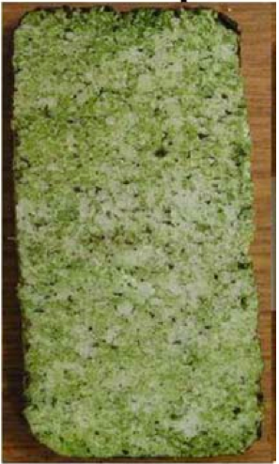
Re-growth
Initial growth
Residual colonies
Fresh support material
Used support material
Biomass harvested by scraping

Slide 19
Biomass yield (g/m²)

Slide 20
TFA yield (g/m²)

Slide 21


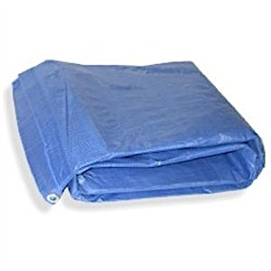
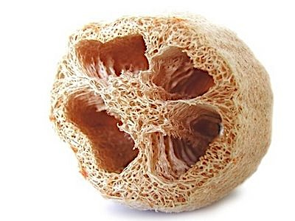
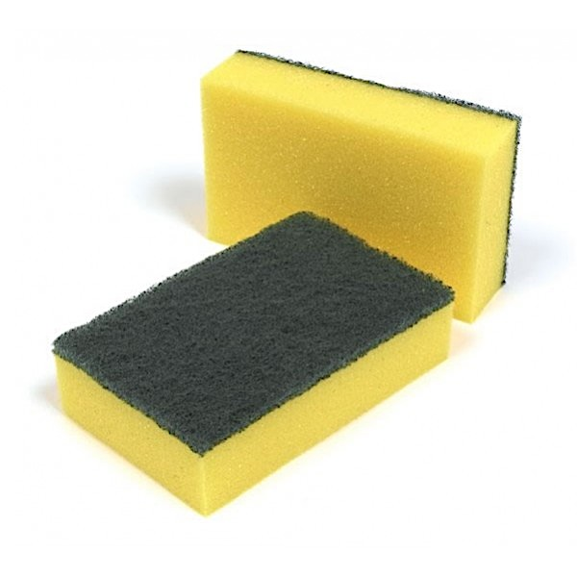
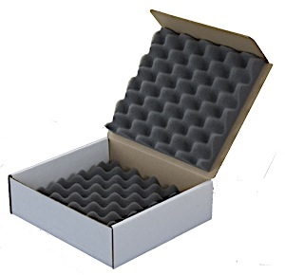
Support materials
Inexpensive
Reusable
Easy to produce
Easy to obtain
Polystyrene foam
Cardboard
Polyethylene fabric
Loofah sponge
Nylon sponge
Polyurethane foam

Slide 22
Biomass yield
g DW/m²

Slide 23
TFA Yield
g/m²

Slide 24
Fatty acid composition

Slide 25
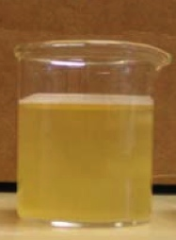
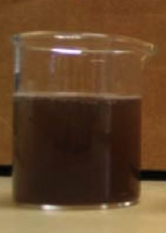
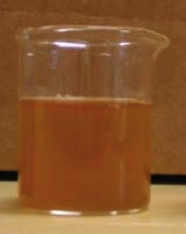
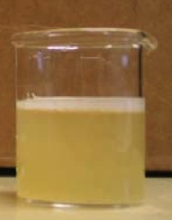
Bioremediation
Initial dairy manure wastewater
After 15 days of alga culture
After 6 days of alga culture
After 10 days of alga culture

Slide 26
Effectiveness of bioremediation for different compound
%
Initial growth

Slide 27
Effectiveness of bioremediation for different compound
%
Regrowth

Slide 28
Conclusion
Attached system can increase the production of algofuel.
This system is reusable.
That is a great tool for remediate the wastewater.

Slide 29
Prospects
Found a support material that is not a derivate of oil.
Try this system with other nutrient medium.
Try this system on an industrial scale.

Slide 30
References
APPLIED MICROBIOLOGY AND BIOTECHNOLOGY
Volume: 85 Issue: 3 Pages: 525-534 Published: JAN 2010
“Development of an attached microalgal growth system for biofuel production”
NATIONAL GEOGRAPHIC
Volume: 212 Number 4 Page 38-59 Published: OCT 2007:
"Green Dreams".

